Slide 1
How to Identify Residual Excessive Daytime Sleepiness in Obstructive
Sleep Apnea
Christina Finch, MD
Clinical Sleep Physician and Associate Professor
University of California San Diego
San Diego, CA

Slide 2



Resource Information
About This Resource
These slides are one component of a continuing education program available online at MedEd On The Go titled Obstructive Sleep Apnea: Emerging Therapies for Excessive Daytime Sleepiness
Program Learning Objectives:
Utilize validated diagnostic tools when assessing residual EDS due to OSA.
Understand the burden, risk factors, and prevalence of EDS due to OSA.
Develop an evidence-based, comprehensive treatment plan for the management of EDS due to OSA.
MedEd On The Go®
www.mededonthego.com
This content or portions thereof may not be published, posted online or used in presentations without permission.
This content can be saved for personal use (non-commercial use only) with credit given to the resource authors.
To contact us regarding inaccuracies, omissions or permissions please email us at support@MedEdOTG.com

Slide 3
Disclaimer
The views and opinions expressed in this educational activity are those of the faculty and do not necessarily represent the views of Total CME, LLC, the CME providers, or the companies providing educational grants. This presentation is not intended to define an exclusive course of patient management; the participant should use their clinical judgment, knowledge, experience, and diagnostic skills in applying or adopting for professional use any of the information provided herein. Any procedures, medications, or other courses of diagnosis or treatment discussed or suggested in this activity should not be used by clinicians without evaluation of their patient's conditions and possible contraindications or dangers in use, review of any applicable manufacturer’s product information, and comparison with recommendations of other authorities. Links to other sites may be provided as additional sources of information.

Slide 4
What Is EDS?
Definition: Inability to stay awake and alert during the major waking episodes of the day, resulting in periods of irrepressible need for sleep or unintended lapses into drowsiness or sleep
  Severity varies, more likely to occur in sedentary or boring settings
  Prodrome varies, awareness of sleepiness versus “sleep attacks”
  Different from fatigue: Lack of energy (mental or physical)

Slide 5
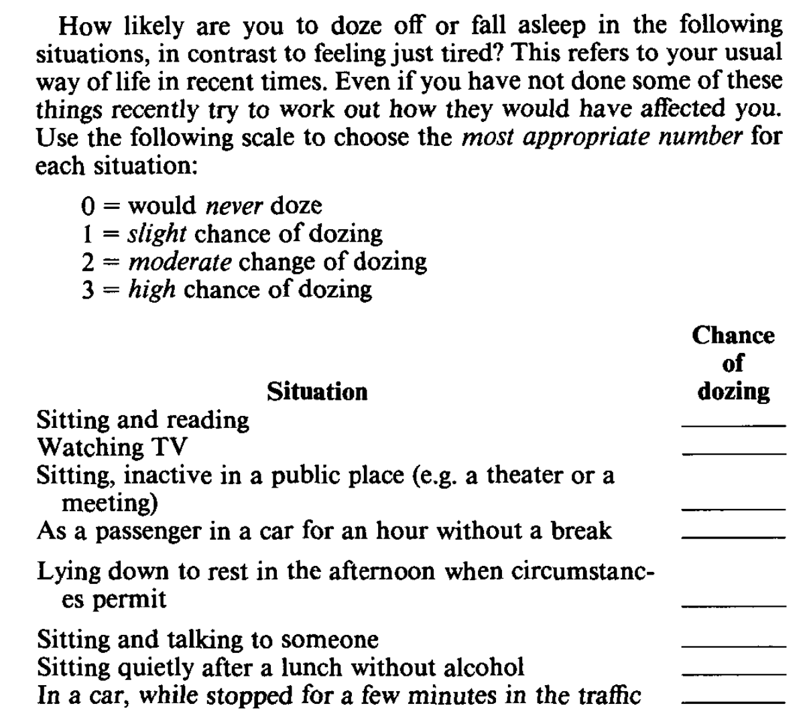
Subjective Evaluation of Excessive Daytime Sleepiness
Epworth Sleepiness Scale (ESS)
GOLD STANDARD
Self-reported likelihood of dozing off or falling asleep in 8
situations of daily life
Designed to distinguish normal subjects from patients with
sleep conditions, including OSA
Scores range 0 to 24
  > 10 abnormally sleepy
    6 = baseline population mean of healthy adults
    16+ in sleep disorders (narcolepsy, IH,
    mod-severe OSA)
    Doesn’t capture all patients, some who are sleepy
    may have normal ESS score

Slide 6
Objective Evaluation of Excessive Daytime Sleepiness in OSA
Multiple Sleep Latency Test (MSLT)
    Daytime in-laboratory test to obtain objective data, physiological tendency to fall asleep
      Typically not indicated in OSA, used in the diagnosis of central hypersomnolence such as narcolepsy or idiopathic hypersomnia
      Average time it takes to fall asleep over course of 5 20-minute nap opportunities (other component is depth of sleep, more important in narcolepsy/IH diagnosis than EDS)
    < 8 minutes is diagnostic threshold, found to be best cutoff for diagnosing narcolepsy/IH along with presence of sleep onset REM periods (SOREMPs)
      Below 5 minutes ➔ sleepiness
      Over 10 minutes ➔ normal alertness
Maintenance of Wakefulness Test (MWT)
  Infrequent in-laboratory test to evaluate wakefulness
    Four 40-minute attempts to stay awake while sitting in bed

Slide 7
What Is Residual EDS in OSA?
Persistent subjective sleepiness despite adequate amounts of sleep and optimal treatment of their sleep apnea and other known sleep disorders
  3+ months confirmed treatment via:
    Optimal PAP compliance data, ideally 7+ hours per night, no elevated residual AHI or mask leak
    PSG with treatment in place demonstrating resolution of OSA and absence of another sleep disorder
  Other causes of sleepiness ruled out:
    Primary: Insufficient sleep, medical or psychiatric comorbidities, medication/drug side effect, rarely central disorders of hypersomnia
    Secondary: Result of poor sleep due to other sleep disorders, such as sleep-related breathing disorders, circadian rhythm sleep-wake disorders, sleep-related movement disorders

Slide 8
Summary
Incorporation of the ESS in routine clinical practice is an easy way to monitor for residual EDS in patients who are compliant with treatment for OSA for a minimum of 3 months
It is important to rule out non-OSA causes of EDS when considering therapy for residual EDS in OSA
Persistent subjective sleepiness despite adequate amounts of sleep and optimal treatment of their sleep apnea and other known sleep disorders should not be ignored

Slide 9



Looking for more resources
on this topic?
CME/CE in minutes
Congress highlights
Late-breaking data
Quizzes
Webinars
In-person events
Slides & resources
www.MedEdOTG.com

