Slide 1
Treatment Options for the Management of Narcolepsy
Ana C. Krieger, MD, MPH
Professor of Clinical Medicine
Departments of Medicine, Neurology and Genetic Medicine
Weill Cornell Medical College
Cornell University
New York, NY

Slide 2
Resource Information
About This Resource
These slides are one component of a continuing education program available online at MedEd On The Go titled Narcolepsy: The Life Essential 8 Connection
Program Learning Objectives:
Improve the accuracy and timing when diagnosing patients suffering from narcolepsy
Educate HCPs on how narcolepsy increases cardiovascular risk
Address how treatment of narcolepsy can improve sleep, which is a pillar of the AHA Life Essential 8, albeit with the caveat of a potentially high salt load
MedEd On The Go®
www.mededonthego.com
This content or portions thereof may not be published, posted online or used in presentations without permission.
This content can be saved for personal use (non-commercial use only) with credit given to the resource authors.
To contact us regarding inaccuracies, omissions or permissions please email us at support@MedEdOTG.com

Slide 3
Disclaimer
The views and opinions expressed in this educational activity are those of the faculty and do not necessarily represent the views of Total CME, LLC, the CME providers, or the companies providing educational grants. This presentation is not intended to define an exclusive course of patient management; the participant should use their clinical judgment, knowledge, experience, and diagnostic skills in applying or adopting for professional use any of the information provided herein. Any procedures, medications, or other courses of diagnosis or treatment discussed or suggested in this activity should not be used by clinicians without evaluation of their patient's conditions and possible contraindications or dangers in use, review of any applicable manufacturer’s product information, and comparison with recommendations of other authorities. Links to other sites may be provided as additional sources of information.

Slide 4
Overview
Chronic disease without a known cure or disease-modifying treatment
Affecting an estimated 0.05% of the population
Predominant feature is daytime sleepiness, in NT1 associated cataplexy
Treatment is focused on
Education – discuss state rules for mandatory reporting if applicable
Non-pharmacological approaches
Pharmacotherapy
Also screen for co-morbid conditions (OSA, RLS, DM, anxiety/depression)
Treatment goal is symptomatic improvement of sleepiness and associated symptoms (e.g. cataplexy, fragmented nocturnal sleep, sleep inertia, hallucinations, etc.)

Slide 5
Non-pharmacological***
Establish a regular sleep-wake schedule
Avoiding alcohol intake
Avoid the use of sedatives or medications leading to drowsiness
Scheduling short daytime naps
Keeping regular physical activity
Keeping adequate weight
Discussions about safety
*** Especially important during pregnancy and in the pediatric population

Slide 6
Pharmacotherapy
Drug | DEA Controlled Substance | Strength of recommendation | Clinical outcome | Improvement in
Modafinil | Schedule IV | Strong (Pediatric Conditional) | EDS | Disease Severity and QoL
Armodafinil | Schedule IV | Conditional | EDS | Disease Severity
Solriamfetol | Schedule IV | Strong | EDS | Disease Severity and QoL
Pitolisant | N/A | Strong | EDS/cataplexy | Disease Severity
Sodium Oxybate | Schedule III | Strong (Pediatric Conditional - age 7+) | EDS/cataplexy | Disease Severity
Methylphenidate | Schedule II | Conditional (no RCT) | EDS
Dextroamphetamine | Schedule II | Conditional (no RCT) | EDS | Disease Severity
Oxybates: sodium oxybate (SXB) and low sodium oxybate (LXB - 92% less sodium) are taken twice nightly; sodium oxybate extended release (ER) is once at bedtime

Slide 7
Medications dosage and potential side-effects
Drug | Mechanism of action | Usual Dosage (adults) | Side effects
Modafinil | Increases DA signaling by blocking DA reuptake | 100-400mg every morning or 200mg twice a day | Headache, nausea, dry mouth, nervousness, insomnia
Armodafinil | R-enantiomer of modafinil | 150-250mg/day | Same as modafinil
Solriamfetol | DA and NE reuptake inhibitor | 75-150mg/day | Headache, nausea, decreased appetite, anxiety
Pitolisant | Histamine H3 receptor inverse agonist | 8.9-35.6mg once a day | Headache, insomnia, nausea, anxiety
Oxybates* | GABA-B receptors | 2.25-4.5gm at bedtime and repeated after 2.5 -4 h | Severe sedation, dizziness, nausea, urinary incontinence, sleepwalking mood swings, depression, weight loss, psychosis
Methylphenidate | Blocks reuptake of monoamines | 10-30mg BID; 20mg ER QAM + 10-20mg IR PRN | Anorexia, headache, nervousness, nausea, vomiting, palpitations,insomnia
Dextroamphetamine | Promotes monoamine release: DA>NE>5-HT | 5-30mg BID; 10mg ER QAM + 10-20mg IR PRN | Anorexia, headache, nausea, insomnia
Sodium Oxybate ER formulation is 6-9gm once per night

Slide 8
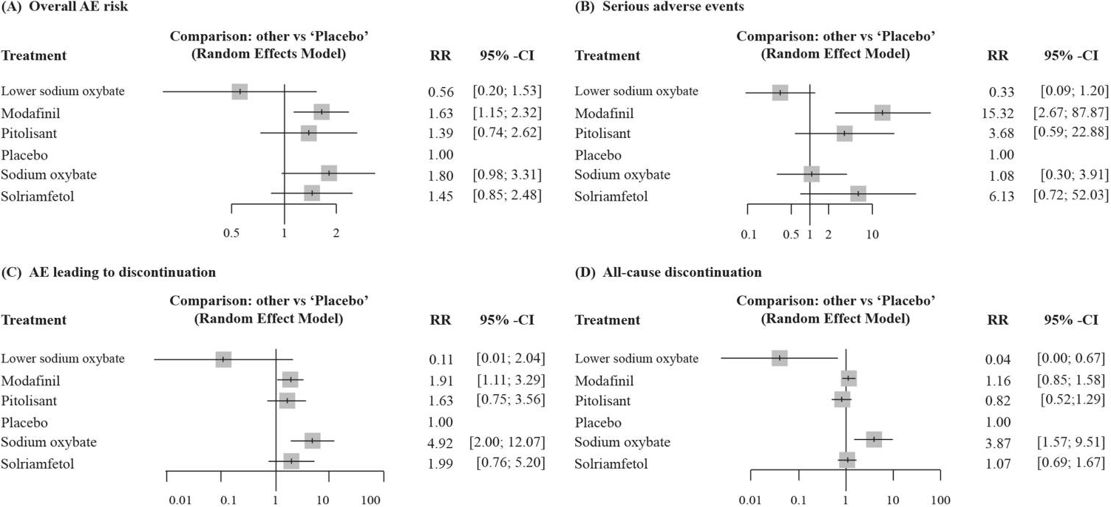
Meta-analysis Forest plots for safety outcomes
Low sodium Oxybate:
Lowest AE risk of all medications
Also had the highest improvement in CGI (data not shown)

Slide 9
Looking for more resources on this topic?
CME/CE in minutes
Congress highlights
Late-breaking data
Quizzes
Webinars
In-person events
Slides & resources
www.MedEdOTG.com

