Slide 1
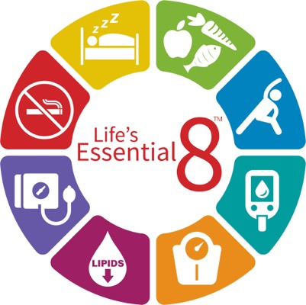
Life’s Essential 8 Diet Paradigm: The Narcolepsy Connection
Lee Surkin, MD, FACC, FCCP, FASNC, FAASM
Founder, American Academy of Cardiovascular Sleep Medicine
President, Empire Sleep Medicine
Chief Medical Officer, VirtuOx Inc.
Chief Medical Officer, Nexus Dental Systems
Greenville, NC

Slide 2



Resource Information
About This Resource
These slides are one component of a continuing education program available online at MedEd On The Go titled Narcolepsy: The Life Essential 8 Connection
Program Learning Objectives:
Improve the accuracy and timing when diagnosing patients suffering from narcolepsy
Educate HCPs on how narcolepsy increases cardiovascular risk
Address how treatment of narcolepsy can improve sleep, which is a pillar of the AHA Life Essential 8, albeit with the caveat of a potentially high salt load
MedEd On The Go®
www.mededonthego.com
This content or portions thereof may not be published, posted online or used in presentations without permission.
This content can be saved for personal use (non-commercial use only) with credit given to the resource authors.
To contact us regarding inaccuracies, omissions or permissions please email us at support@MedEdOTG.com

Slide 3
Disclaimer
The views and opinions expressed in this educational activity are those of the faculty and do not necessarily represent the views of Total CME, LLC, the CME providers, or the companies providing educational grants. This presentation is not intended to define an exclusive course of patient management; the participant should use their clinical judgment, knowledge, experience, and diagnostic skills in applying or adopting for professional use any of the information provided herein. Any procedures, medications, or other courses of diagnosis or treatment discussed or suggested in this activity should not be used by clinicians without evaluation of their patient's conditions and possible contraindications or dangers in use, review of any applicable manufacturer’s product information, and comparison with recommendations of other authorities. Links to other sites may be provided as additional sources of information.

Slide 4
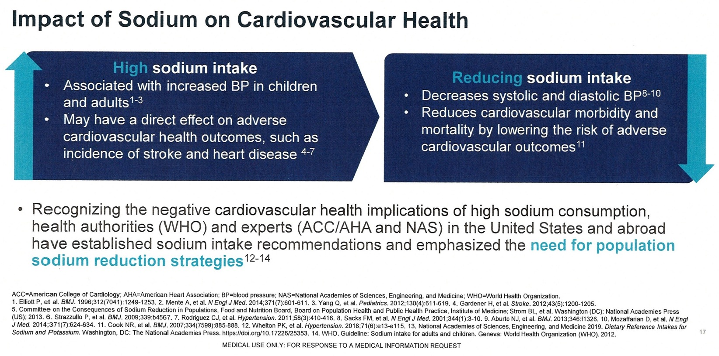
Sodium and Cardiovascular Health

Slide 5
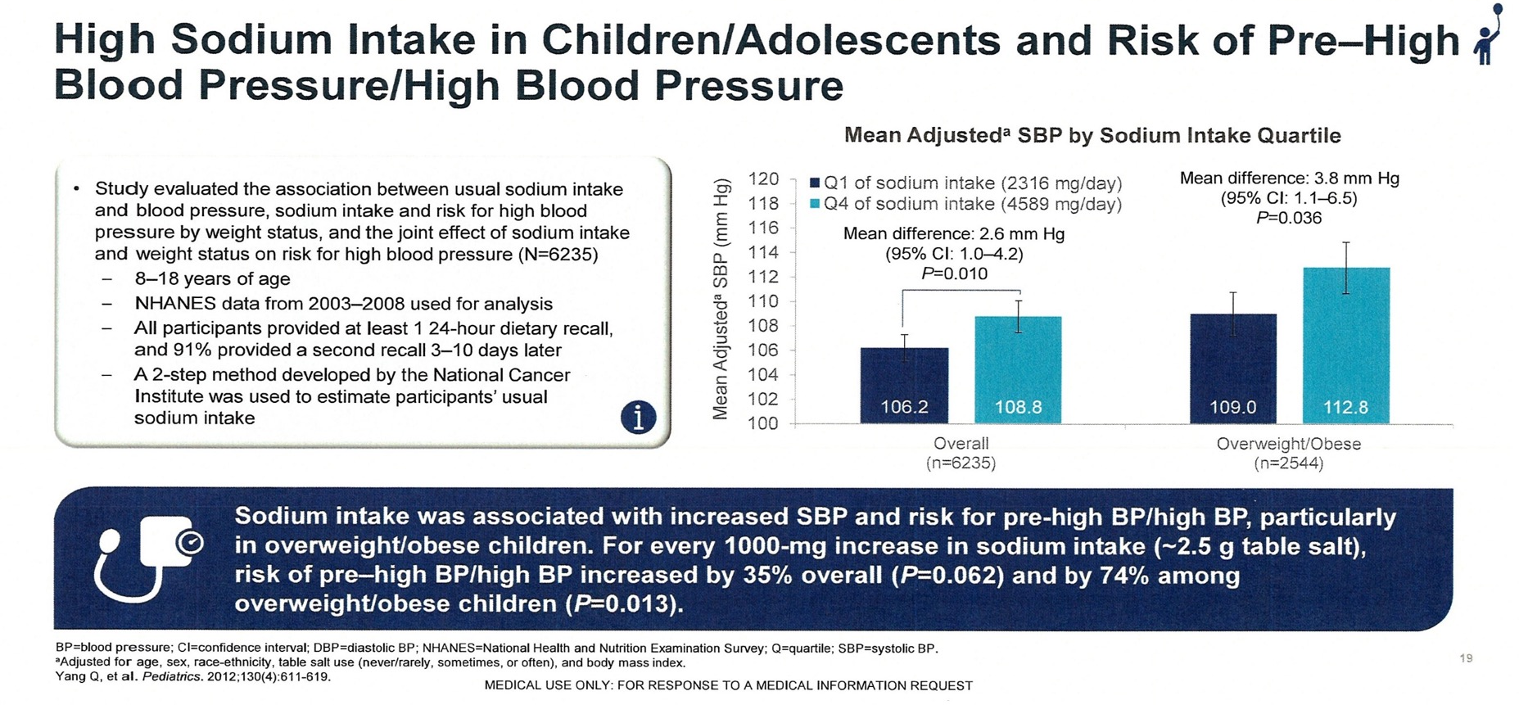
Sodium and Cardiovascular Health

Slide 6
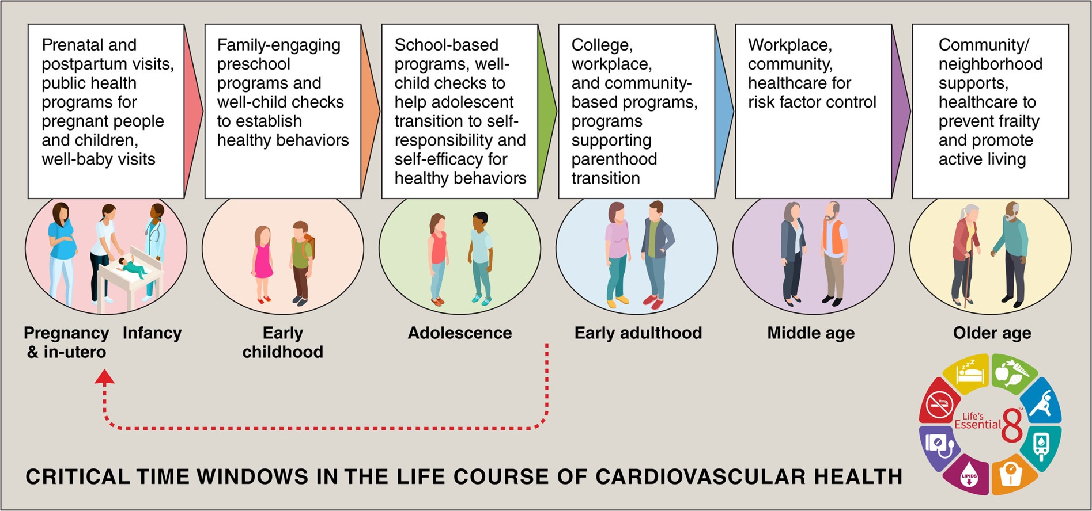

Slide 7
CARDIA-SSBP Trial
213 individuals, 50-75 years old with and without HTN
Usual diet: 5g/day; Low-sodium diet: 1.3g/day
73.4% on low sodium diet reduced SBP by 4 mmHg (0-8 mmHg)
Diabetics reduced SBP by 17 mmHg
HTN affects 1.3B people worldwide and is major CV risk factor
HTN = hypertension
SBP = systolic blood pressure

Slide 8
FDA Position on Sodium
“The tendency for blood pressure to rise with age is seen mostly in western countries where sodium intakes are high.”
>100M American adults have high blood pressure which generally rises with age.
Children and adolescents more likely to have high blood pressure associated with higher sodium intake.
High blood pressure is a major risk factor for heart disease and stroke.
“Reducing sodium intake has the potential to prevent hundreds of thousands of premature deaths and illnesses in the coming years.”

Slide 9
Consider Sodium Intake When Treating Narcolepsy Patients
Sodium intake matters for everyone
High sodium containing drugs, which offer beneficial symptomatic relief for patients with narcolepsy, may potentially increase blood pressure and risk for cardiovascular events³
Counseling patients on dietary modification is essential when using higher sodium containing pharmacotherapy
Now available is a low-sodium drug option for management of narcolepsy symptoms

Slide 10



Looking for more resources
on this topic?
CME/CE in minutes
Congress highlights
Late-breaking data
Quizzes
Webinars
In-person events
Slides & resources
www.MedEdOTG.com

